Slide 1


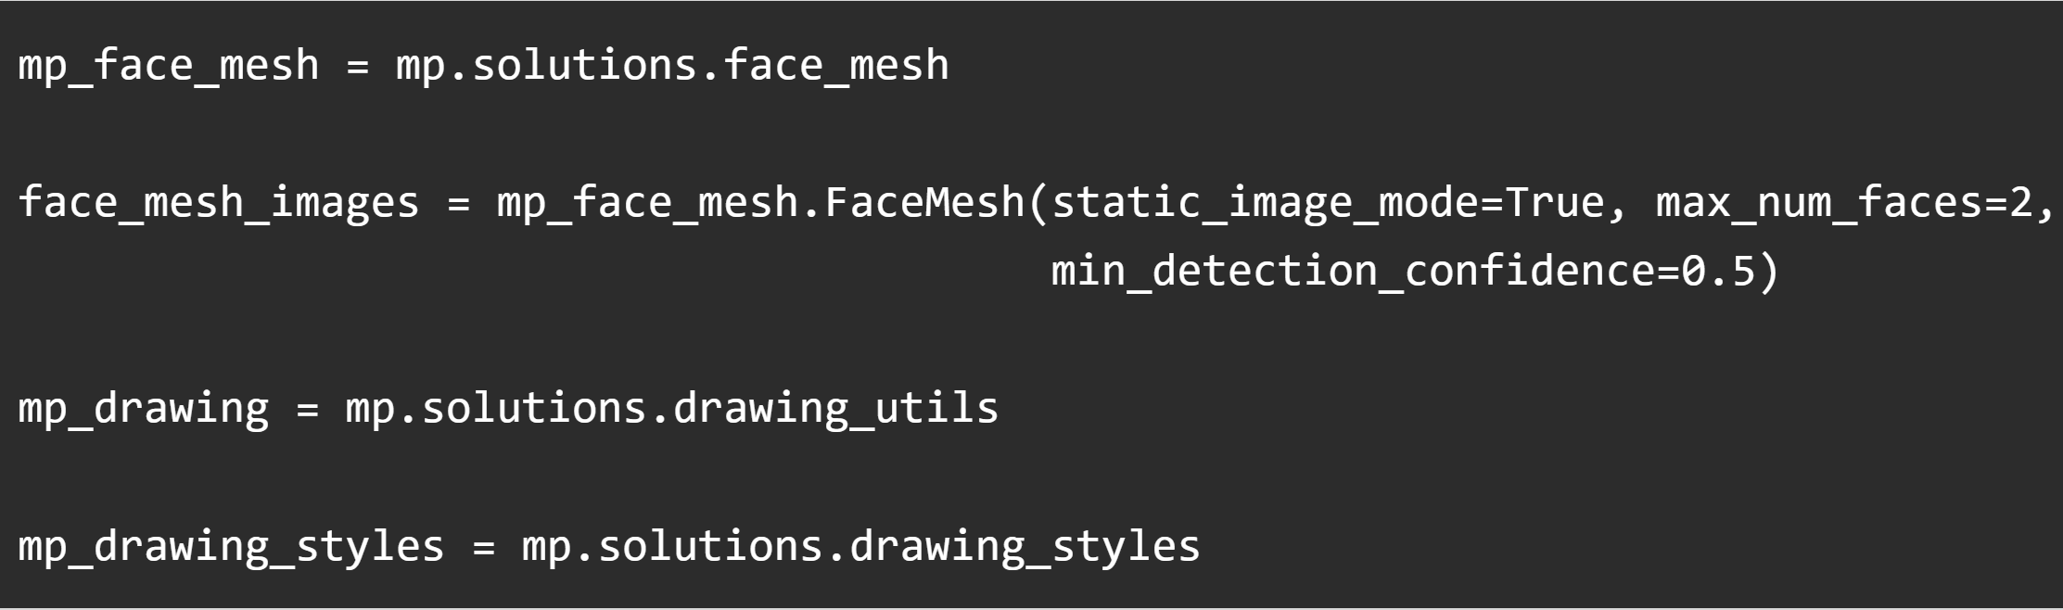
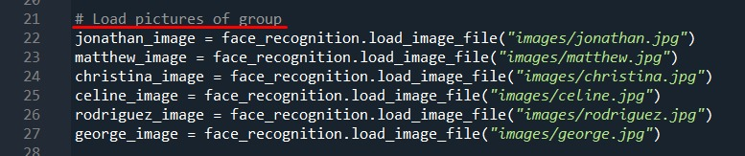
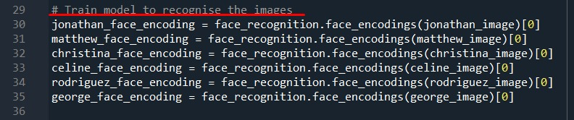
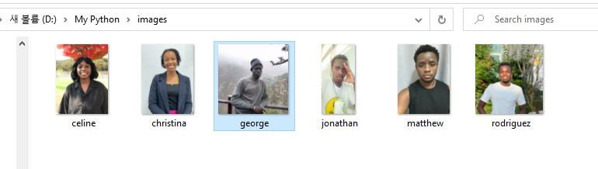
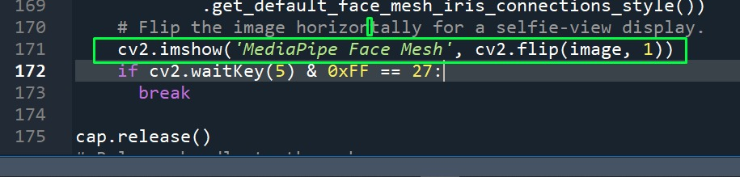
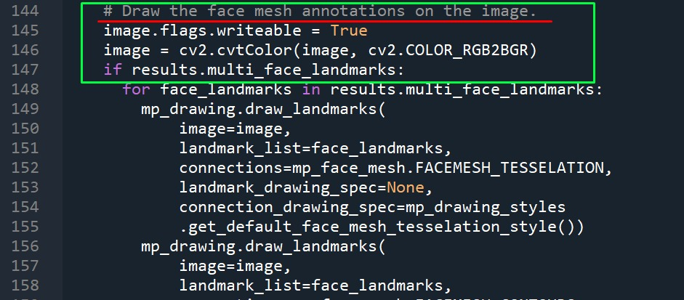
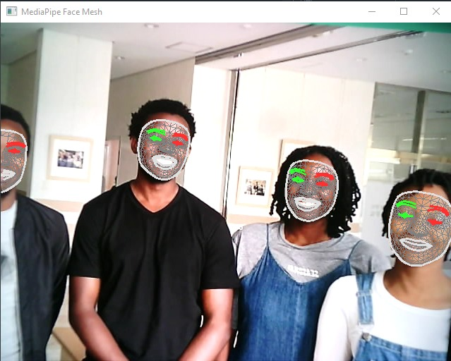
Facial Landmarks Detection Using Mediapipe Library
Matthew A. Oguru, George Garang, Jonathan M. Kalibala,
Christina J. Mjema, Rodrigue Ntagashobotse, and Celine N. Wafula
Bachelor of Smart Computing,
Kyungdong University Global Campus, Gosung, 24764, Korea
Abstract
Facial landmarks detection is applicable in many fields, from the generation of facial filters in social media applications to security and identity verification. In this project, a facial landmarks detection model is implemented using Mediapipe solution packages. The facial landmarks solution offers various implementations including image-based and real-time detection with allowance for a defined number of faces per instance. The model successfully detects facial landmarks even on faces positioned at an angle.
Importing the Libraries and Initialization
The required libraries imported were:
mediapipe
cv2
itertools
numpy
matplotlib
time
The facial landmarks points detection model is initialized using mediapipe as follows:
Code breakdown:
Calling functions to draw, specifying a maximum number of faces to detect, and drawing styles.
Load Images and Training
Code breakdown: the training images are loaded into the system then training takes place
Creating the video display for real-time detection
Drawing the Results
Resultant Image:
Conclusion
This project shows how facial landmarks in an image can be detected by the help of the mediapipe library in python

